Slide 1

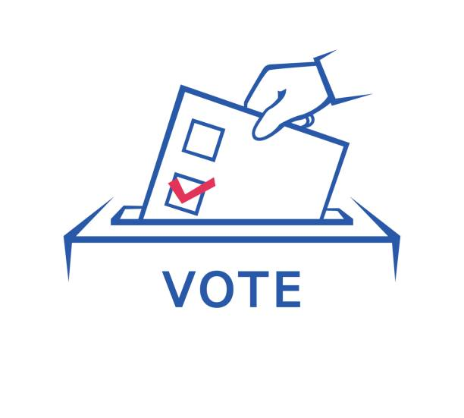
DAB 103 Project Election Polls
Section = 002
Group = The Legion

Slide 2



Team Members
Krim Patel
Karan Patel
Harshil Patel

Slide 3



Team Members
Jayraj Radadiya
Surbhi Patel
Rajvi Mehta

Slide 4
Introduction
Decisions in the United States are held for government authorities at the administrative, state, and neighborhood levels.
At the government level, the country's head of express, the president, is chosen by implication by individuals of each state, through an Electoral College. Today, these voters quite often vote with the well-known vote of their state.
The most well-known technique utilized in U.S. decisions is the first-past-the-post (Plurality voting system) framework, where the most noteworthy surveying applicant wins the election. Under this system, a candidate needs only a majority of the votes to win, instead of a direct majority. Some may use a two-round system, where if no one gets the required votes then there is competition between the two who gets the most votes.
Citizens rank the competitors arranged by inclination as opposed to deciding in favor of a solitary applicant. Assuming a competitor gets the greater part of the votes cast, that up-and-comer wins. In any case, the competitor with the least votes is wiped out. Voting forms appointed to the disposed of the competitor are related and allocated to those of the excess applicants who rank next arranged by inclination on each voting form.
All individuals from the government council, the Congress, are straightforwardly chosen by individuals of each state.
Github Link :- GitHub - jayrajradadiya789984/DAB_103_Project_2022

Slide 5
Project Proposal
Opinion polls are often aimed to depict a population's views by asking a series of questions and then extrapolating generalities in ratios or within confidence intervals.
The term "pollster" refers to someone who conducts polls. To educate people about the voting process.
To inform residents about the relevance of Electors Photo Identity Cards (EPIC) and how to utilize them in various government initiatives, such as passport processing and bank account opening.
Encourage citizens to participate in democracy by enrolling in electoral rolls and voting at election time. Examine how the United States' election administration contributes to the functioning of democracy. Define the role of polling stations and local precincts in the electoral process.

Slide 6
Target Audience
Mostly government political parties (both ruling and opposition) will make use of historical data to forecast the future poll and media will telecast by analyzing the election poll.
Political campaigns have information about Americans and how they utilize it to design their plans.
The two major political parties in the United States strive to utilize the most precise statistics to target voters in several ways.
This information may be used by political campaigns to assist them decide who to reach out to, how to contact them, and how they might react to various messages.

Slide 7
Problem Statement
Pollster has created vivid type of polls to collect vote through different methodology namely, Online, IVR/Online, Live Phone, IVR/Online/Text, Live Phone/Online.
Usage of different method to collect vote is convenience for Candidate to use preferable polls to give vote.
Candidate-specific information, such as State, methodology used, and so on, will be included in the polls.
To avoid identity theft and duplication, the first upload must be done under the supervision of a trustworthy pollster.
The votes recorded on the identity details MUST be secret, and the counting of votes is done from the polls itself once the votes have been read.

Slide 8
Analysis Questions
As the data set is based on the election many analytical questions can arise in ones mind the few of the major ones are:
The winning Party ?
The candidates of the party ?
Classifying the voters and find the total number of voters ?
Pollster responsible for conducting the polls across the US statewise ?
We can the further below see the solutions to above and other analytical questions.

Slide 9
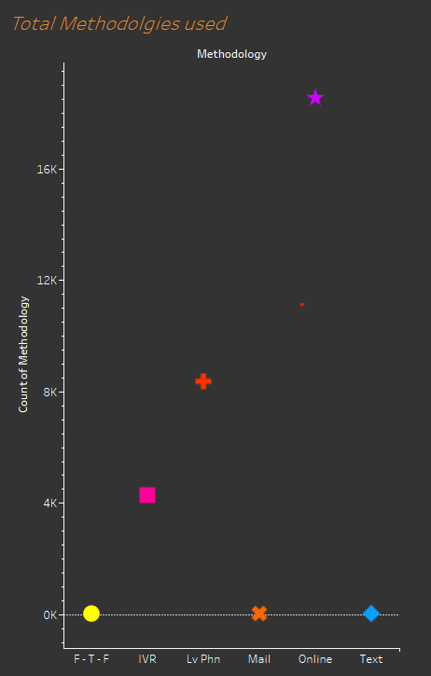
Visualizations
What medium of voting is preferred the most by the voters?
The highest method which is preferred by the voters is the online method as compared to the any other method. In this modern era of technology, it is clearly seen from the graph, mail and text method are not used nowadays.

Slide 10
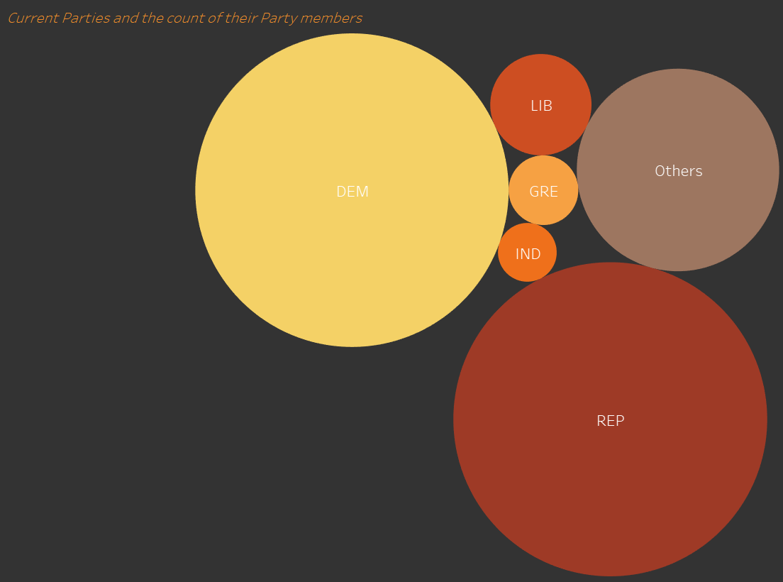
Visualizations
Which political party rules the election and has the highest number of members?
The Republicans and Democrats party has the highest number of members as compared to other political party.

Slide 11
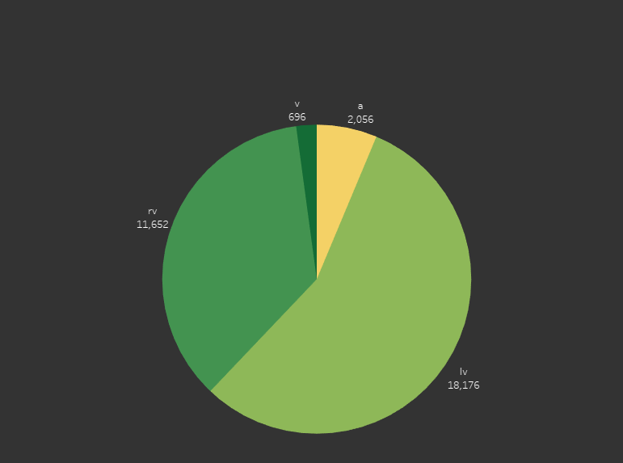
Visualizations
How many people come out to vote?
There is total 18,176 likely voters (Lv) come out to the vote as compared to the RV (registered voters), A(adults), V(voters).

Slide 12
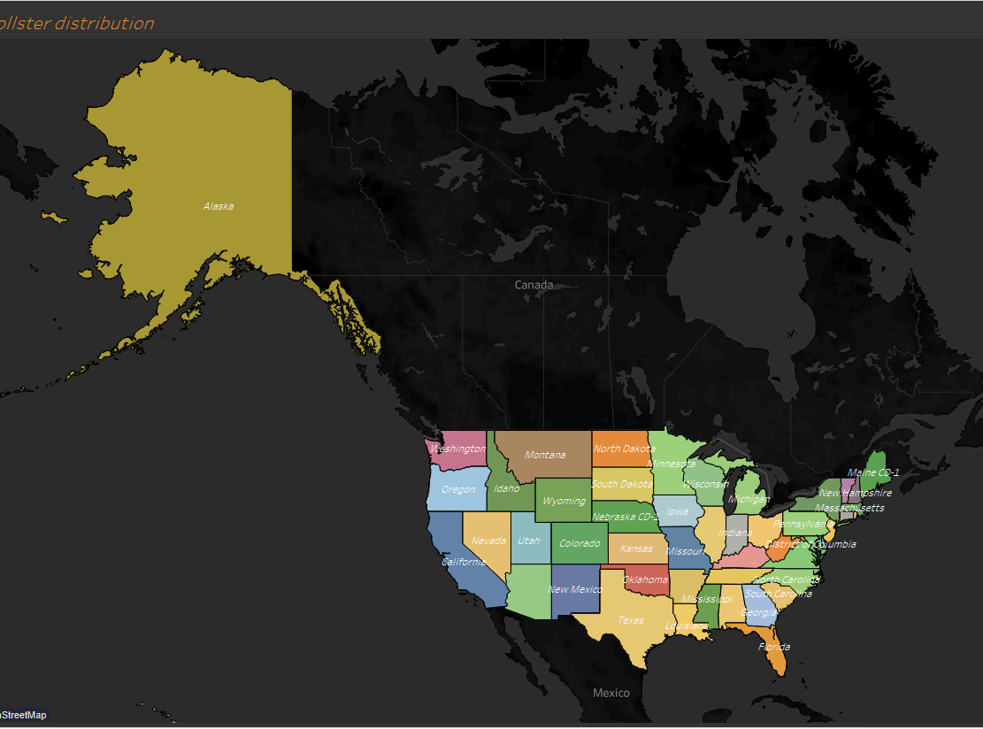
Visualizations
The different pollster assigned to each state?
Different type of pollster is allocated to a specific state to conduct an election poll in United State of America.

Slide 13
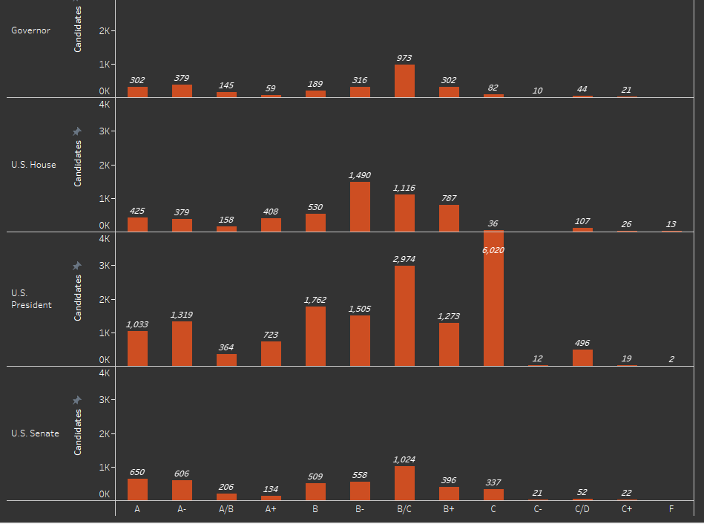
Visualizations
According to the different office types, which candidate has the highest/lowest fte grades?
In governor and U.S. Senate office types, the highest candidates have B/C fte grade, which is 973 and 1024 respectively. Apart from this, 1490 highest candidates have B- fte grade in U.S. House office type. Moreover, it is clearly seen from the graph, C fte grade has the highest candidate which is 6020 in U.S President.

Slide 14
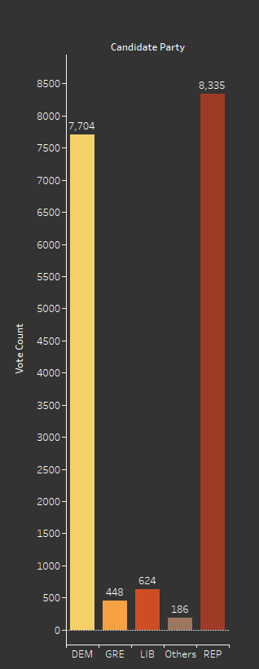
Visualizations
Which party won the most vote?
The candidates from REP have won the highest number of seats by beating all other parties which were fighting election against them.

Slide 15
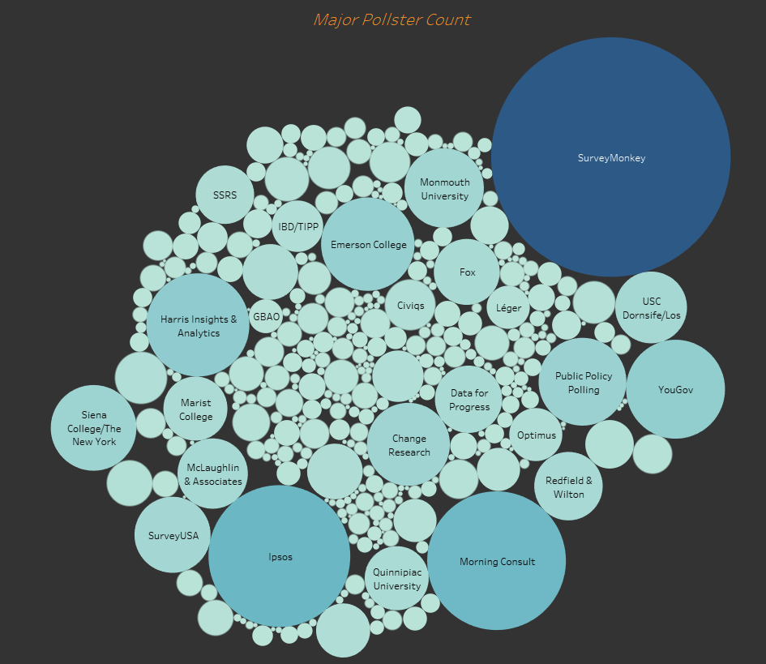
Visualizations
Which pollster counts more winning probability for election in USA?
SurveyMonkey has the highest number of polls counting as compared to another pollster. Morning Consult and lpsos has almost same number of polls counting.

Slide 16
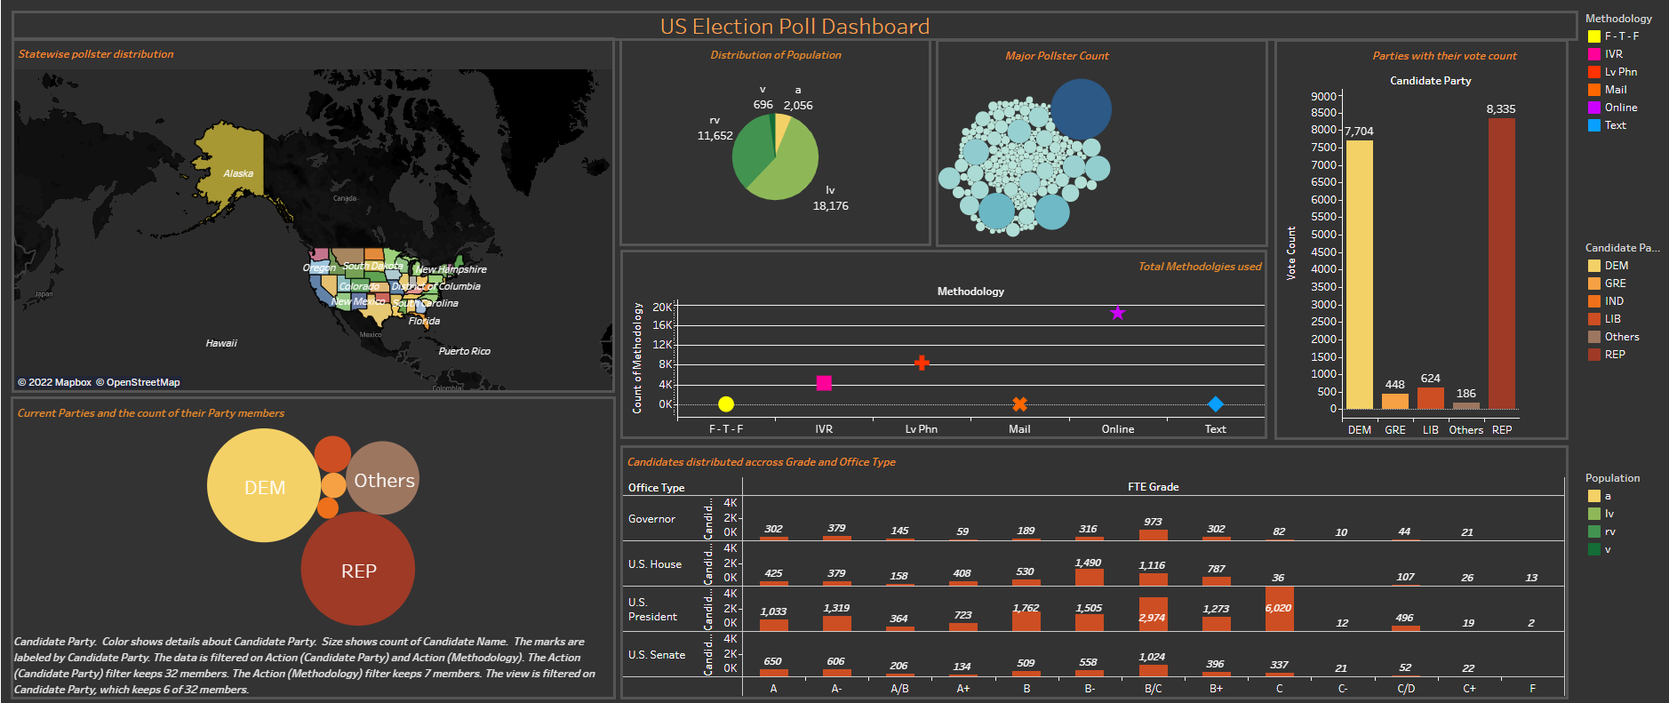
Dashboard
Dashboard Link : - https://public.tableau.com/app/profile/jayraj.radadiya/viz/DAB103_Project_TheLegion/Dashboard?publish=yes

Slide 17
Conclusion
We can conclude that from the above visualization we can clearly see that the most used method to vote is Online and least one are Online/Text. Also the Republic party (REP) is biggest party in terms of candidates with the difference of almost 631 more candidates. Also The republic party is seen to be dominating with more number of votes.
We can even analyze that the SurveyMonkey is the leader in having the pollster .We can see that the pollsters are distributed across the Country. After looking on the count of Lv(Likely Voters) its is seen that they can cause impact to election result because of being high in numbers.
We can also find that most of the candidates are of between B/C to C Category for the elections in US.
Overall, we can see the Republic party to being heavier on the Democratic party for the elections.

Slide 18
Reference
https://en.wikipedia.org/wiki/Elections_in_the_United_States#Election_information_on_the_web
https://www.pewresearch.org/fact-tank/2020/10/29/what-we-can-trust-2020-election-polls-to-tellus/
https://www.ubcpress.ca/asse
https://journals.sagepub.com/doi/abs/10.1177/1541931213571289?journalCode=proe

